Slide 1


Predicting Landing Solutions for a Rocket in a Two-Body System
Carl De Vries & JJ Xue Hu

Slide 2
Motivation for Research
Can we obtain a reliable curve fit to show direct relationships between parameters for a model?
Expanded upon a case study for landing a rocket on the lunar surface.
Edwards, C. Henry, and David E. Penney. Differential Equations & Boundary Value Problems Computing and Modeling. 4th ed. Upper Saddle River: Pearson Custom, 2008. Print.
Notes:
Analytical integration yields a function y=f(x)+c where we can enter x values and return y values. Can we directly approximate parameters for landing solutions using data points obtained using a numerical method to form a reliable best-fit curve?
Non-linear ODEs cannot be solved analytically, this approximation & curve fitting technique may provide an alternative solution. This investigation examines the reliability of this approximation technique.
If the best-fit curves are reliable, it will be easier to obtain landing solutions using this technique rather than running many numerical method trials.
Starting from a case study provided two advantages:
1. Allowed us to validate our numerical ODE solver (C++).
2. Gave us an initial landing solution we could base our data off of.

Slide 3
Tools
Numerical method: 4th order Runge-Kutta (RK4)
Considered an accurate method for integrating differential equations.
RK4 calculates a weighted average slope from four points.
Programming language: C++
C++ automated the RK4 process.
Plots & Graphs: Microsoft Excel
Excel used to apply the best-fit curves.
Notes:
The data points we used in this projects are obtained using the 4th Order Runge-Kutta numerical method.
4th order Runge-Kutta provides accurate approximations, especially for smooth curves.
The weighted average of 4 slopes is used to reach the final approximation (k₁-k₄)
k₁ is calculated at the beginning of the interval. k₂ and k₃ are calculated at the mid-mid point of the current interval. k₄ is calculated at the end of the interval.
k₁ & k₂ are given a larger weight, because they are typically better representations of the slope across the entire interval.
To approximate the Y value at the next point, add the Y value at the current point to the a weighted slope times the interval’s step size.

Slide 4
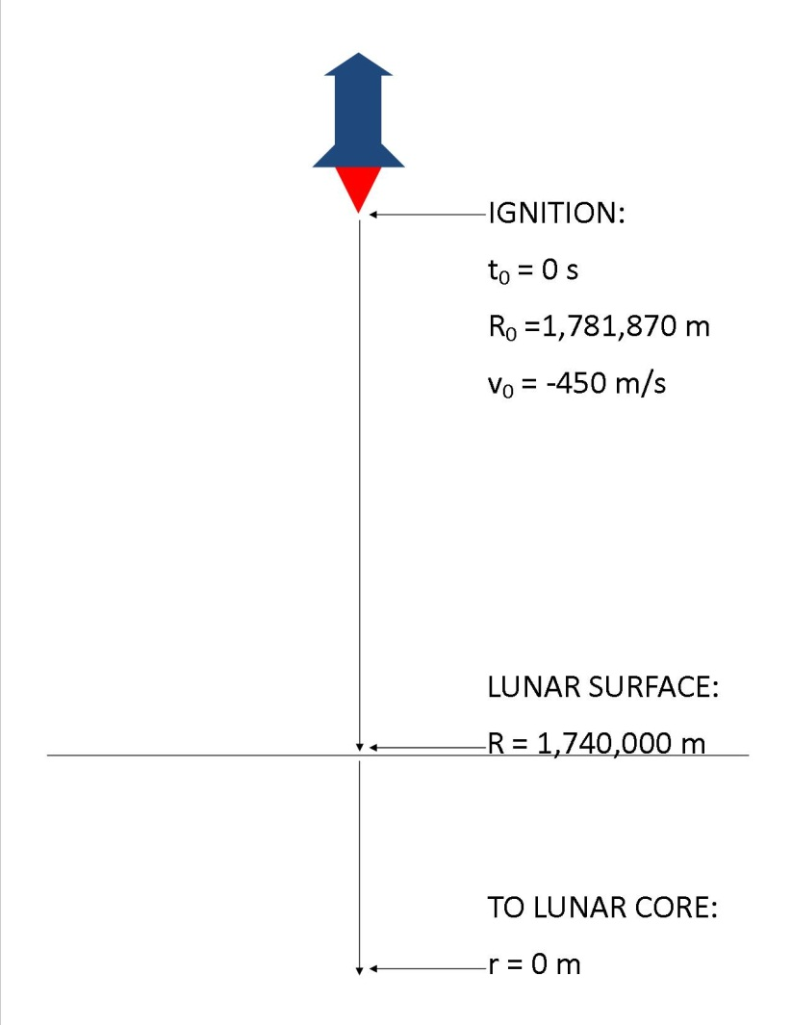

Scenario
System of Equations:
Position: $r(t)$ for $r\left(0\right)=1,781,870$
Velocity: $\frac{dr_{1}}{dt}=v(t)$ for $v\left(0\right)=−450$
Acceleration: $\frac{dr_{2}}{dt}=\frac{dv}{dt}=T−\frac{GM}{r^{2}}$
Constants:
Deceleration from thrust: T = 4 m/s²
Gravitational constant: G = 6.6726 x 10⁻¹¹ N*m²/kg²
Lunar mass: M = 7.35 x 10²² kg
Additional Inputs:
Upper limit of integration: t_{n} = 200 s
Number of steps: n = 200
Step size: h = 1 s
Notes:
The system of 1st order differential equations is needed to use a numerical ODE solver.
Altitude is measured from the center of the moon
Calculate initial conditions analytically
Use a chain rule substitution.
Integrate using separation of variables.
Evaluate at T=0 and T=4.
Set the equations equal and solve.

Slide 5
Case Study Results
Time | Case Study Altitude | Simulation Altitude | Case Study Velocity | Simulation Velocity
180 | 1740059 | 1740059 | -16.83 | -16.83
181 | 1740044 | 1740043 | -14.45 | -14.45
182 | 1740030 | 1740030 | -12.07 | -12.07
183 | 1740019 | 1740019 | -9.69 | -9.69
184 | 1740011 | 1740011 | -7.31 | -7.31
185 | 1740005 | 1740005 | -4.93 | -4.93
186 | 1740001 | 1740001 | -2.55 | -2.55
187 | 1740000 | 1740000 | -0.17 | -0.17
188 | 1740001 | 1740001 | 2.21 | 2.21
189 | 1740004 | 1740004 | 4.59 | 4.59
190 | 1740010 | 1740010 | 6.97 | 6.97
Notes:
The table and graphs on the current slide show the data within a reduced domain.
The LT is highlighted at 187 seconds.
LA perfectly matches R, but LV is just with a tolerance deemed reasonable by the authors. Remember these are approximations.
The altitude at t=181 is off by 1. However, the following approximations return to match the expected solutions for the entire data set.
The validation showed us our RK4 method is reliable for integrating while using different parameters.

Slide 6
Interpolation
Notes:
1. Independent variable is acceleration from thrust. Domain 3.5 to 4.5.
2. Landing solutions were found by running trials similar to the previous slide and identifying the time when [r] and [v] are both within a given tolerance. Tolerances were chosen because they are negligible compared to the initial values.
1. Altitude tolerance is ±5m. Las are 0.00028% or less of the initial fixed altitude.
2. Velocity tolerance is ±1m/s. LVs are within 0.25% or less of the initial velocity.
3. The curves are approximated with Microsoft Excel. All curves fit with 2nd order polynomials.
1. IVvsRD coefficient of determination, R² =1.
2. LTvsRD coefficient of determinationR² = 0.9995.
INTERPOLATION
Interpolations for LTvsRD are within 0.30% of the numerical solutions.
Interpolations for IVvsRD are within 0.001% of the numerical solutions.

Slide 7
Extrapolation
Notes:
Extrapolations within ±0.25 of the edges of the data set are within 1% of their numerical solutions.
3. Landing T vs. Rocket Deceleration has a minimum located at T=5.49. The unexpected change in concavity decreases the accuracy of the estimation beyond that point. IVvsRD will eventually encounter a minimum.
4. No conclusive data sets yet, but:
1. Preliminary trials suggest a power fit improves extrapolations for LTvsRD.$t=600.14x^{−0.84}$
2. Preliminary trials suggest a logarithmic curve is best suited for IVvs RD. $v=−372\ln\left(x\right)+75.565$

Slide 8
Results
Choose a domain so all the estimations are interpolations.
Avoid curve fits with changes in concavity.
Future Investigations:
Examine data using a different independent variable.
Increase the model’s complexity to investigate the relationships between a larger number of parameters.
Notes:
1. To make reliable predictions, choose a domain containing all points we wish to estimate.
2. Curve fits with many changes in concavity (high-order polynomials) aren’t good fits for this particular set of data. 3. Non-polynomial curve fits show a possibility for increased accuracy for extrapolations. Power fit for LTvsRD and Logarithmic fit for IVvsRD.
Change the independent variable to view the relationships from a different perspective.
Choose the variable which is the primary constraint so it’s easier to keep the estimations within the constraint.
The points may be easier to fit.
2. Adding drag from standard atmosphere, mass from burning fuel, mass from staging. We can look for relationships between a larger number of parameters.

